Slide 1

Digital ELECTRONICS
UNIT-II
BOOLEAN ALGEBRA

Slide 2
UNIT – II: Boolean algebra
Boolean algebra, Postulates and theorems
Standard representation for logic functions
K-map representation,
simplification of logic functions using K-map
Boolean function minimization using Quine-Mclusky method.

Slide 3
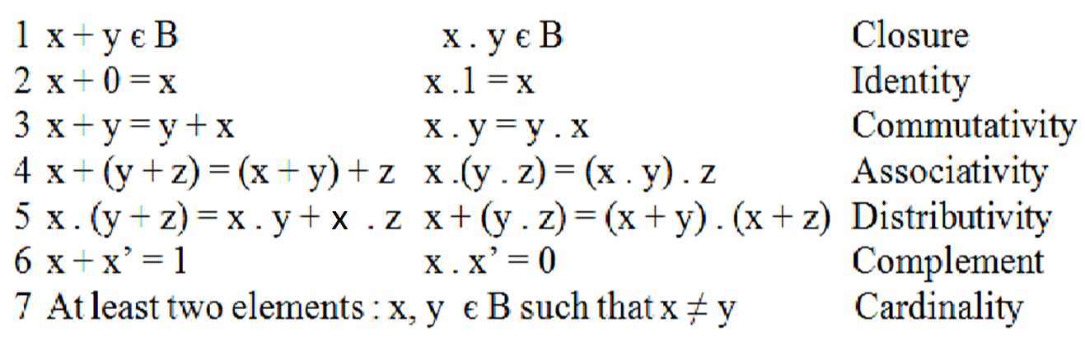
Axiomatic definition of Boolean algebra
Boolean algebra is an algebraic structure defined by a set of elements
together with two binary operators ‘+’ and ‘.’ provided that the
following postulates are satisfied.

Slide 4


Postulate : Closure Property
Closure(a):
when two binary elements are operated by operator + the result is a unique binary element
OR operator (plus/Addition)
Closure(b):
When two binary elements are operated by operator .(dot),the result is a unique binary element AND operator(dot/multiplication)

Slide 5


Postulate: Identity or Idempotency Property
There exists unique elements 1(one) and 0(zero) such that:
(a) x + x = x
x + 0 = x
(b) x . x= x
x . 1= x
Where 0 is the identity element for the OR operator and 1 is the identity element for the AND operator

Slide 6
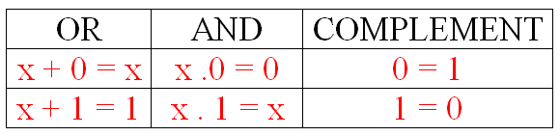
Postulate : Complementation Property
For every x in β there exists a unique element x’ such that:
x + x’ = 1 x . x’ = 0
Properties of 0 and 1 Element
Notes:
6

Slide 7
Duality Property
If a Boolean expression is true, the dual of expression also true.
To find the dual, follow the following steps:
(1) Change + operator to . operator
(2) Change . operator to + operator.
(3) Change 0 to 1 and 1 to 0 .
Example: Dual of relation X + X’ = 1 is X . X’ =0.
Duality is a very important property of boolean algebra.
Notes:
7

Slide 8
Basic Boolean Theorems

Slide 9
Theorem1 : Idempotency
(a) A + A = A
Proof:
A + A = (A + A) . 1
= (A + A). (A + A’)
= A A + A A’ + A A + A A’
= A A+ A A’
= A + 0
=A
(b) A . A = A
Proof:
A . A = A . A + 0
= A . A + A .A’
= A ( A + A’)
= A . 1
= A
Notes:
9

Slide 10

Perfect Induction Method
(b) A . 0 = 0
Proof:
0 . 0 = 0
=> A . 0 = 0
1 . 0 = 0
A . 0 = 0 by the duality theorem
(a) A + 1 = 1
Proof:
A + 1 = 1 . (A + 1)
= (A + A’) (A + 1)
= A.A + A.1 + A’ .A + A’.1
= A +A+ 0 + A’
= A + A’
= 1

Slide 11
Theorem 2: Involution
A’’ = A
Proof:
0’’ = 0
=> A’’ = A
1’’ = 1

Slide 12
Theorem 3 : Absorbtion
(a) A + AB = A
Proof:
A + AB = A . 1 + AB
= A(1+B)
= A . 1
= A
A (A+B) = A
Proof:
A (A + B) = A . A + AB
= A + AB
= A

Slide 13
Examples of Absorption theorem
(a) A + A’ B = A + B
Proof:
A + A’ B = A + AB + A’B
= A + B .( A + A’)
= A + B .1
= A + B
A . (A’ + B) = AB
Proof:
A . ( A’ + B) = (A + AB) . (A’ + B)
= A A’ + AB + A’AB+ ABB
= AB + ABB
= AB + AB
= AB

Slide 14

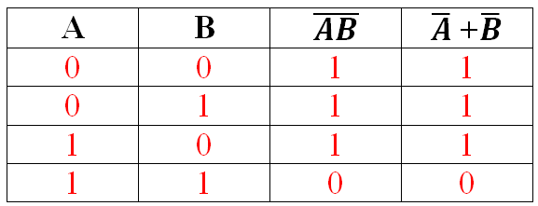
Theorem4: DeMorgan’s Theorems
DeMorgan suggested two theorems that form an important part of Boolean algebra.
= +
The complement of a product is equal to the sum of the complements
Truth Table:

Slide 15

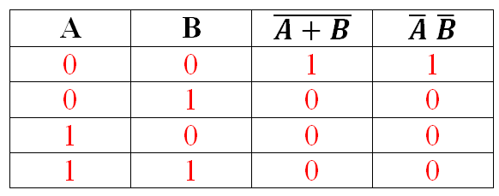
=
(2)
The complement of a sum is equal to the product of the complements
Truth Table:

Slide 16
Theorem5 : Consensus Theorem
The expression of the form AB + A’C+ BC in which the term BC is redundant and can be eliminated to form equivalent expression as AB + A’C
The theorem used for this simplification is known as Consensus theorem and it is stated as
AB + A’C + BC = AB + A’C
Proof:
AB + A’C + BC = AB + A’C + (A + A’) BC
= AB + A’C + ABC + A’BC
= AB + ABC + A’C + A’BC
= AB(1+C) + A’C(1+B)
Since : 1+X=1
= AB + A’C

Slide 17
Binary Operators
x | y | x. y |  | x | y | x + y |  | x | x’
0 | 0 | 0 |  | 0 | 0 | 0 |  | 0 | 1
0 | 1 | 0 |  | 0 | 1 | 1 |  | 1 | 0
1 | 0 | 0 |  | 1 | 0 | 1
1 | 1 | 1 |  | 1 | 1 | 1

Slide 18
x.(y+z) = (x.y)+(x.z)
x | y | z | y+z | x.(y+z) | x.y | x.z | (x.y)+x.z
0 | 0 | 0 | 0 | 0 | 0 | 0 | 0
0 | 0 | 1 | 1 | 0 | 0 | 0 | 0
0 | 1 | 0 | 1 | 0 | 0 | 0 | 0
0 | 1 | 1 | 1 | 0 | 0 | 0 | 0
1 | 0 | 0 | 0 | 0 | 0 | 0 | 0
1 | 0 | 1 | 1 | 1 | 0 | 1 | 1
1 | 1 | 0 | 1 | 1 | 1 | 0 | 1
1 | 1 | 1 | 1 | 1 | 1 | 1 | 1

Slide 19
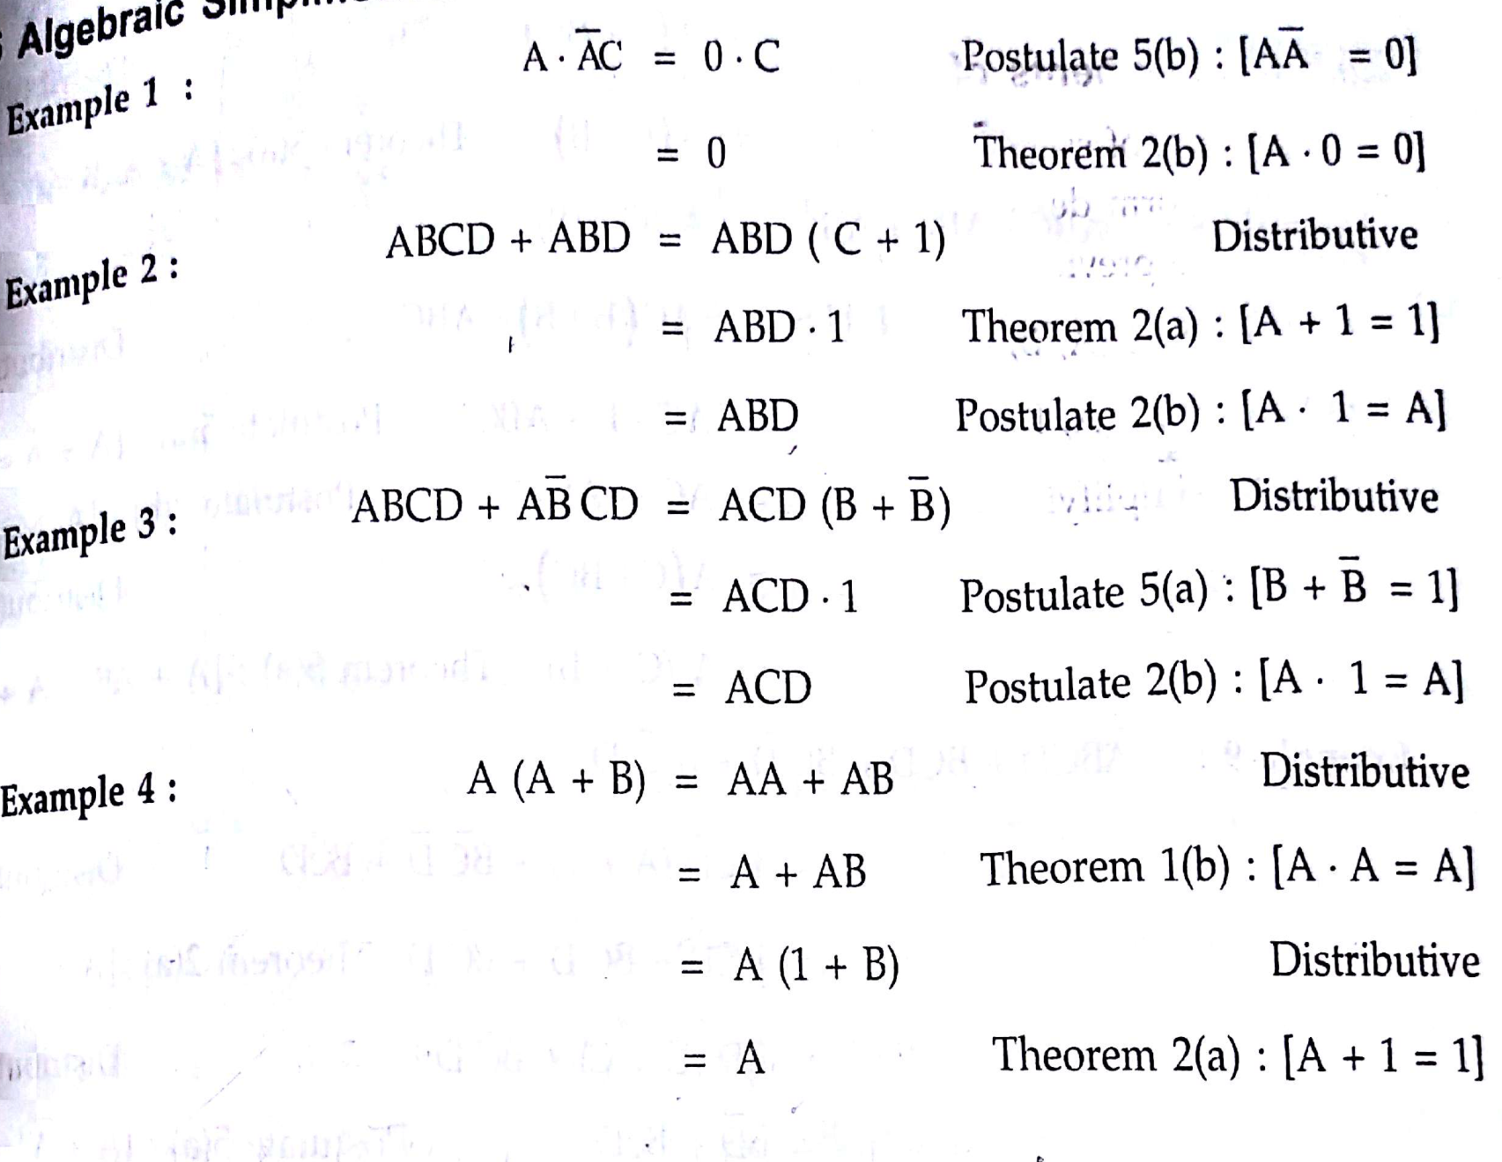

Slide 20

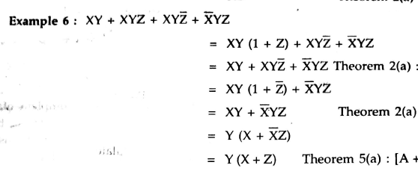
we have: A+A’B=A+B

Slide 21
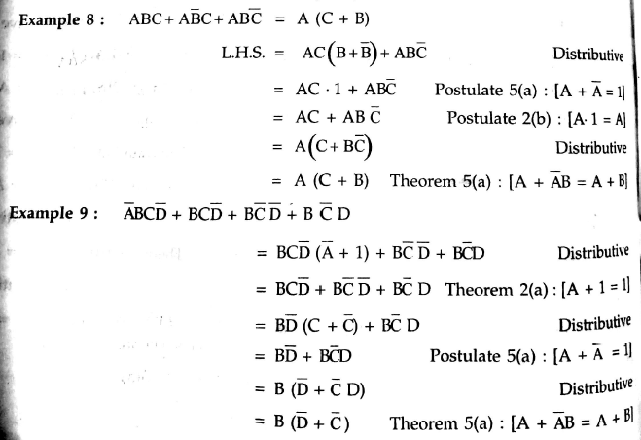

Slide 22
Switching Functions
Switching functions are also called as Boolean Functions
Boolean expressions are constructed by connecting Boolean constants and variables with Boolean operators.
Boolean expressions are also known as Boolean formulae.
Boolean expressions are used to describe Boolean functions
.
Example: The Boolean expression (A + B’) C is used to describe the function f , then the Boolean function written as
f(A, B, C) = (A + B’) C (or)
f = (A + B’) C
Notes:
tru
22

Slide 23
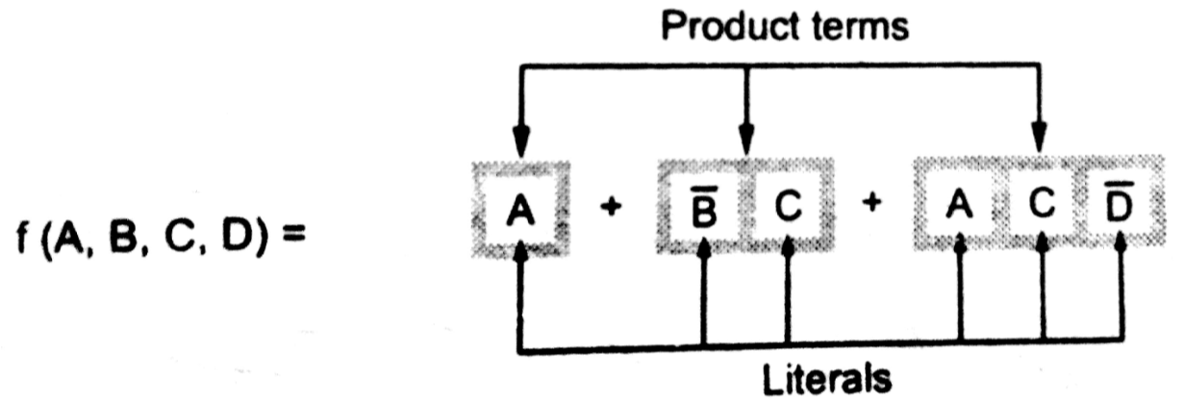
In the following Boolean function, the variables appeared either in a complemented or in an un complemented form
Occurrence of variable either in a complemented or in an un comple-mented form is called a Literal.
A product term is defined as either a literal or product of literals.

Slide 24
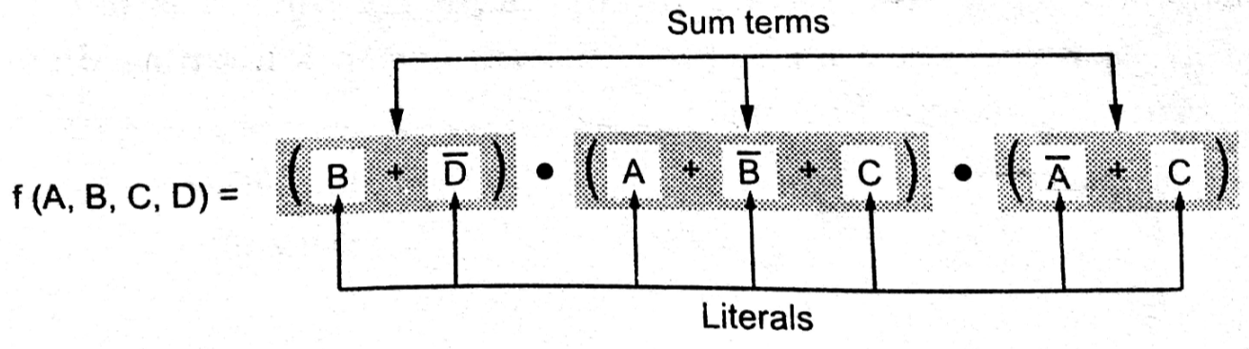
The above Boolean function consists of seven literals, they appear in sum terms.
A sum term is defined as either literal or sum of literals.

Slide 25
Standard Forms
Boolean function can be expressed in the standard form.
In the standard form, the terms that form the function may contain one/two or any number of literals.
The literals and terms are arranged in one of the two standard forms:
(1) Sum Of Products form (SOP)
(2) Product Of Sums form (POS)

Slide 26
Sum Of Products (SOP)
The sum and product are derived from the symbolic representations of the OR & AND functions by + and . Boolean operators
Product term is group of literals that are ANDed together.
example: A.B.C , X.Y
Sum term is group of literals that are Ored together.
example: A + B + C, X + Y

Slide 27



Sum Of Products (SOP): It is a boolean expression containing AND terms, called product terms. Sum(OR) of these product terms having one or more literals called SOP form
Example: Sum
f(A,B,C) = A B + A B’ C’
Product terms
Each of these sum of products expression consist of two or more product terms (AND) that are ORed together
Each product term consists of one or more literals, appear in either complemented or uncomplemented form
The sum of products form is also known as disjunctive normal form

Slide 28


Product Of Sums (POS)
A product of sums is group of sum terms ANDed together.
Example: Product
f(A,B,C) = (A + B) . (B’ + C)
Sum terms
Product of sums expression consist of two or more sum terms (OR) that are ANDed together.
Each sum term consists of one or more literals, appear in either complemented or an un complemented form.
The product of sums form is also known as conjunctive normal form

Slide 29
Canonical Forms
The canonical forms are the special cases of Sum Of Product (SOP) and Product Of Sum (POS) forms .
These are also known as standard Sum Of Product(SOP) and standard Product Of Sum (POS) forms.

Slide 30
Standard SOP Form
In the SOP form all the individual terms do not involve all literals.
Example: AB + A'BC’
Stn SOP= AB(C+C’) +A’BC’=ABC+ABC’+A’BC’
If each term in SOP form contains all the literals, then the SOP form is known as Standard or canonical SOP form.
Each individual term in standard SOP form is called minterm. So it also called as minterm canonical form.
Example: f(A,B,C) = A B’C + A B C + A’ B C’
Each product term consists of all literals in either complemented or un complemented form
Notes:
30

Slide 31
Standard POS form
If each term in POS form contains all the literals, then the POS form is known as standard or canonical POS form.
Each individual term in the standard POS form is called maxterm. So it is also known as maxterm canonical form
Example: f(A,B,C) = (A + B+ C) . (A + B’ + C)
Each sum term consists of all literals in either complemented or un complemented form.

Slide 32
Converting expressions in to standard SOP or POS form
Steps to convert SOP to Standard SOP form:
Step1: Find the missing literal in each product term.
Step2: AND each product term having missing literal with term formed by ORing the literal and its complement.
Step3:Expand the terms by applying distributive law and reorder the literals in the product terms.
Step4: Reduce the expression by omitting repeated product terms, if any. Because A + A = A.

Slide 33
Example
Convert the given expression in to standard SOP form
f(A,B,C) = AC + AB + BC
Solution:
Step1: Find the missing literal in each product term.
f(A,B,C) = AC + AB + BC
Literal B is missing Literal A is missing
Literal C is missing

Slide 34
Step2: AND product term with (missing literal + its complement).
f(A,B,C) = AC.(B+B’) + AB.(C+C’) + BC.(A+A’)
Missing Literals and their complements
Step3: Expand the terms and reorder literals
Expand: f(A,B,C) = ACB +ACB’ + ABC + ABC’ + BCA + BCA’
Reorder: f(A,B,C) = ABC + AB’C + ABC + ABC’ + ABC + A’BC

Slide 35
Step4:Omit repeated product terms
f(A,B,C) = ABC + AB’C+ ABC+ABC’ +ABC + A’BC
We have X+X=X
f(A,B,C) = ABC + A B’C + ABC’ +A’BC
----Standard SOP form (Canonical form)

Slide 36
Steps to convert POS to standard POS form
Step1: Find the missing literal in each sum term, if any.
Step2: OR each sum term having missing literal with term formed by ANDing the literal and its complement.
Step3: Expand the terms by applying distributive law and reorder the literals in the sum terms.
Step4: Reduce the expression by omitting repeated sum terms if any . Because A . A = A.

Slide 37
EXAMPLE
Convert the given POS expression in to standard POS Form
f(A,B,C) = A . (A+B+C)
Solution:
Step1: Find the missing literal in each sum term
f(A,B,C) = (A) . (A+B+C)
Literals B and C are missing

Slide 38
Step2: OR sum term with ( missing literal. Its complement)
f(A,B,C) = ( A + B.B’ + C.C’) ( A + B + C)
Missing literals and their complements.
Step3: Expand the terms and reorder literals.
since we have : A + BC = (A + B) (A + C)
f(A,B,C) = (A + B.B’+ C) (A + B.B’ + C’) (A + B + C)
= (A+C+B.B’) ( A+C’+ B.B’) (A + B + C)
= (A + C + B) ( A + C+ B’) (A + C’+B) (A + C’ + B’) ( A+ B+ C)
On Rearranging
= (A + B + C) ( A + B’ + C) (A + B + C’) (A + B’ + C’) ( A+ B+ C)

Slide 39
Step4: Omit repeated sum terms
f(A,B,C) = (A + B + C) (A + B’ + C) (A + B + C’) (A + B’ + C’) (A + B + C)
f(A,B,C) = (A + B + C) (A + B’ + C) (A + B + C’) (A + B’ + C’)
----Standard POS form (Canonical form)

Slide 40
M-Notations : Minterms and Maxterms
Minterm is a product term having all the variables of the function either in its normal or complimented form
Each individual term in standard SOP form is called Minterm
Maxterm is a sum term having all the variables of the function either in its normal or complimented form
Each individual term in standard POS form is called Maxterm
For an n-variable logical function there are 2^{n} minterms and an equal number of maxterms.

Slide 41
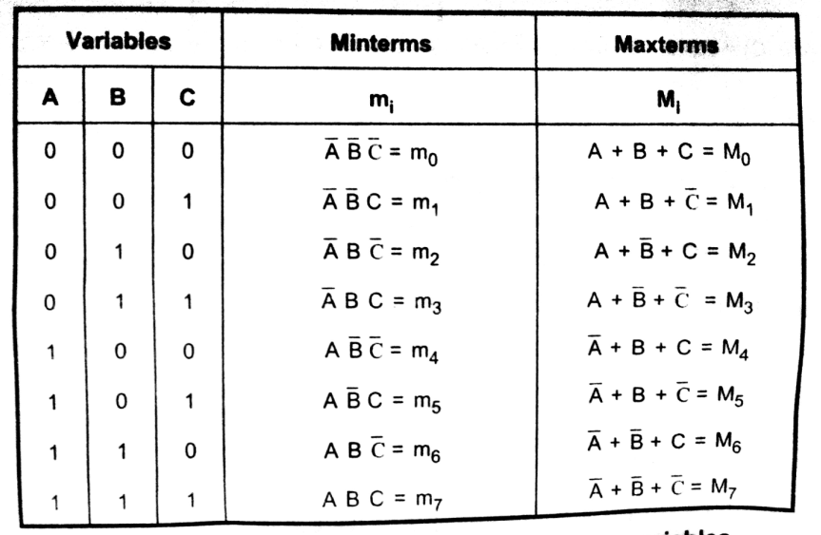
Minterms and Maxterms for Three Variables
Each minterm is represented by m_{i} .
Each maxterm is represented by M_{i} .
Where i is the decimal number equivalent of the binary number

Slide 42


Examples
Minterms:
f( A,B,C) = A’ B’ C’ + A’ B’C + A’ B C + A B C’
= m₀ + m₁ + m₃ + m₆ =
Maxterms:
f( A,B,C) = (A + B + C’) (A + B’ + C’) (A’ + B’ + C)
= M₁ . M₃ . M₆ = Л M (1, 3 ,6)
Where Л denotes product of sums
and
Indicates sum of products

Slide 43
Simplification of Switching Functions using Theorems
Example 1: Simplify the expression Z=A B + A B’ . (A’C’)’
Solution: Apply the Demorgan’s theorem and multiply out all terms.
Z = A B + A B’ . (A’C’)’
= A B + A B’ . (A’’ + C’’).
= A B + A B’ .(A + C)
= A B + A B’ A + A B’ C
= A B + A B’ + A B’ C
= A B + A B’ ( 1 + C)
= A B + A B’
= A ( B + B’)
= A

Slide 44

Example2: Simplify the following three variable expression using Boolean algebra, Y =
Step 1: From the minterms we can write expression in SOP form
Y = A’ B’ C + A’ B C +A B’ C + A B C
Step 2: Search for common terms for factorization
Y = A’ B’ C + A’ B C + A B’ C + A B C
= A’ C ( B + B’) + A C ( B’ + B)
= A’ C + A C
= C ( A’ + A)
= C

Slide 45

Example3: Simplify the following three variable expression using Boolean algebra Y = Л M (3,5,7)
Solution: Y =
From the minterms write expression in SOP form
Y = A’ B’ C’ + A’ B’ C + A’ B C’ + A B’ C’ + A B C’
= A’ B’ C’ + A B’ C’ + A’ B C’ + A B C’ + A’ B’ C
= B’ C’ (A’ + A) + BC’ ( A’ + A) + A’ B’ C
= B’ C’ + B C’ + A’ B’ C
= C’ ( B’ + B) + A’ B’ C
= C’ + A’ B’ C from A + A’ B = A + B
= C’ + A’ B’

Slide 46
SIMPLIFICATION OF BOOLEAN FUNCTIONS by using KARNAUG Map

Slide 47
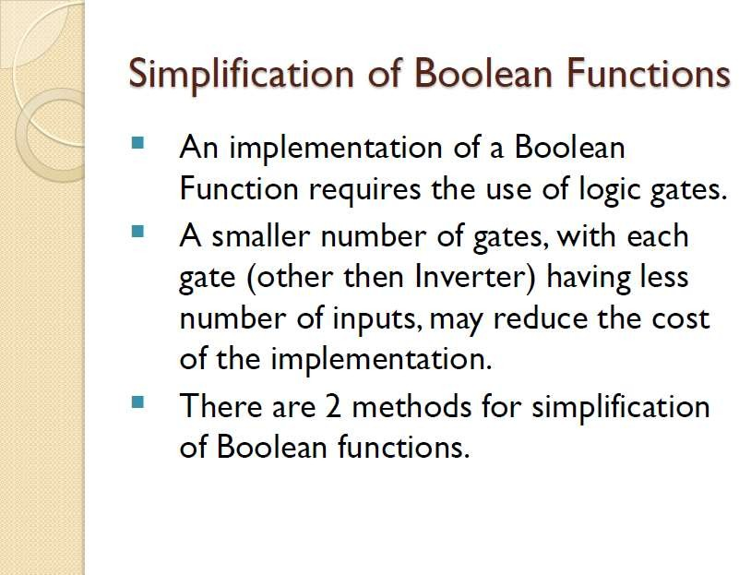

Slide 48
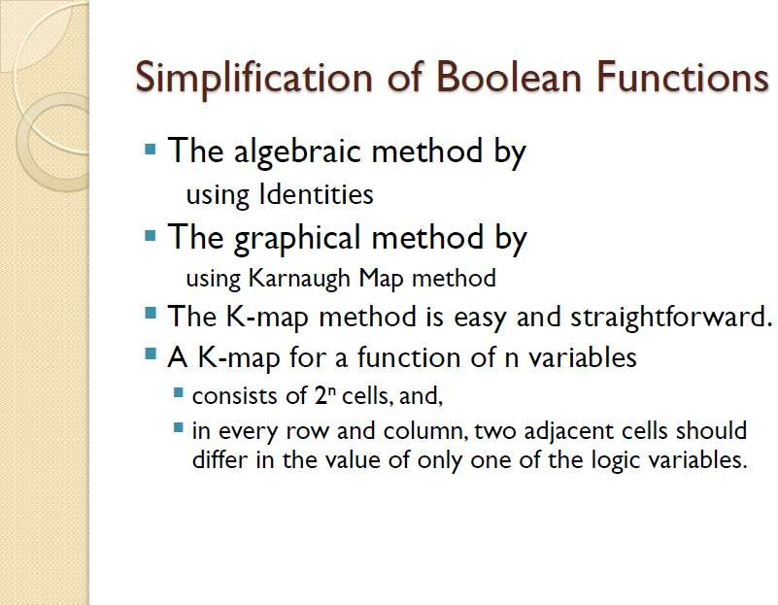

Slide 49
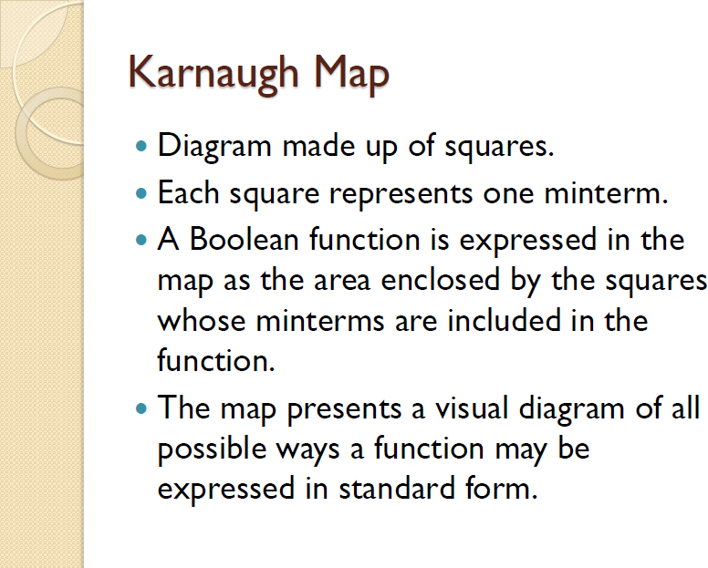

Slide 50
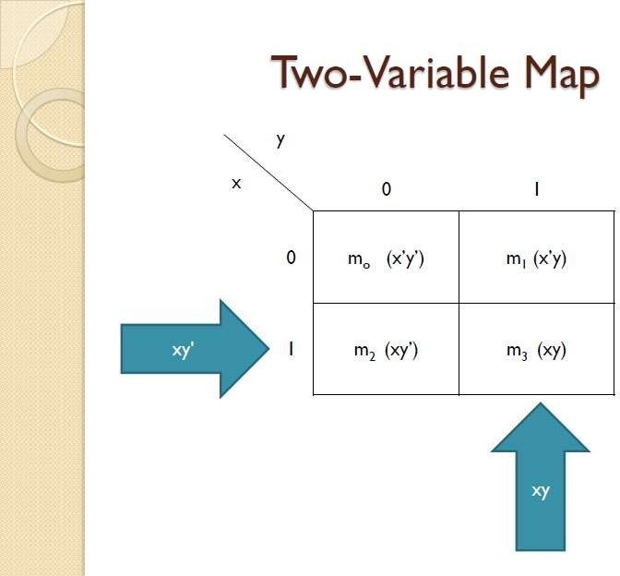

Slide 51
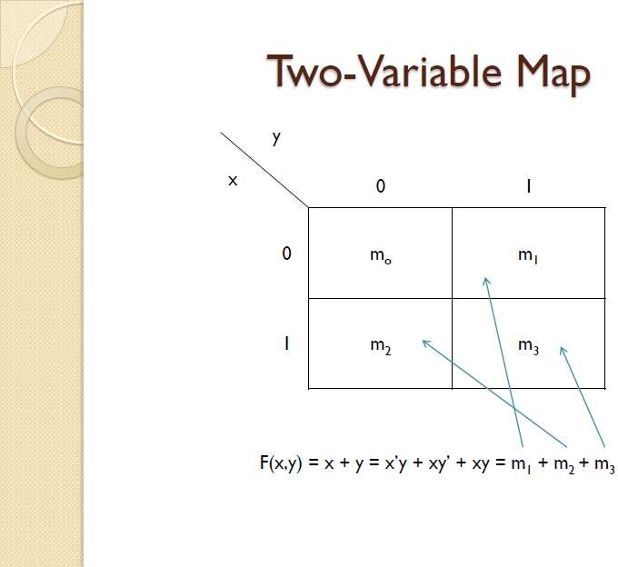

Slide 52
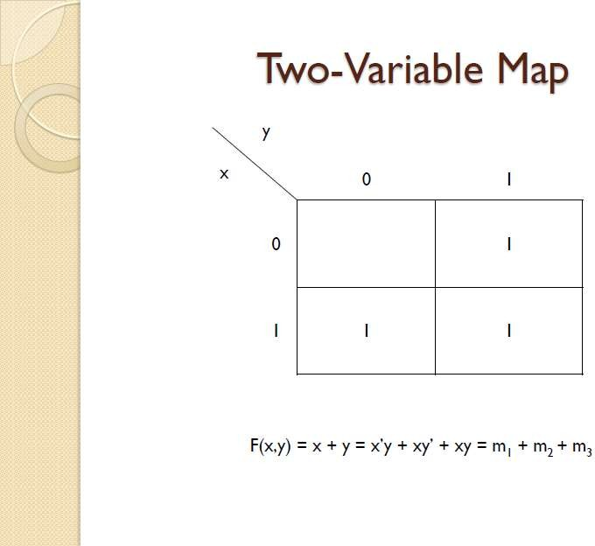

Slide 53
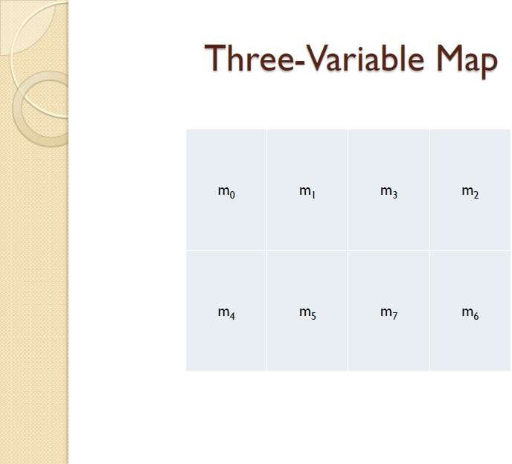

Slide 54
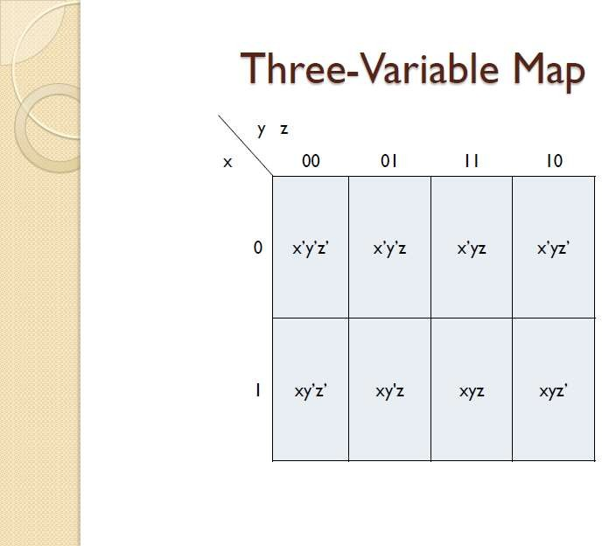

Slide 55
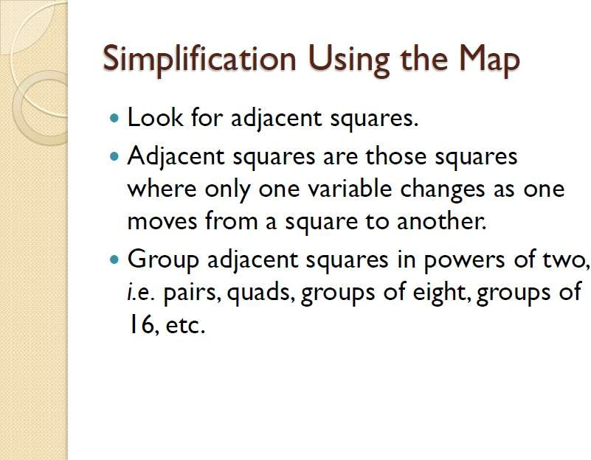

Slide 56
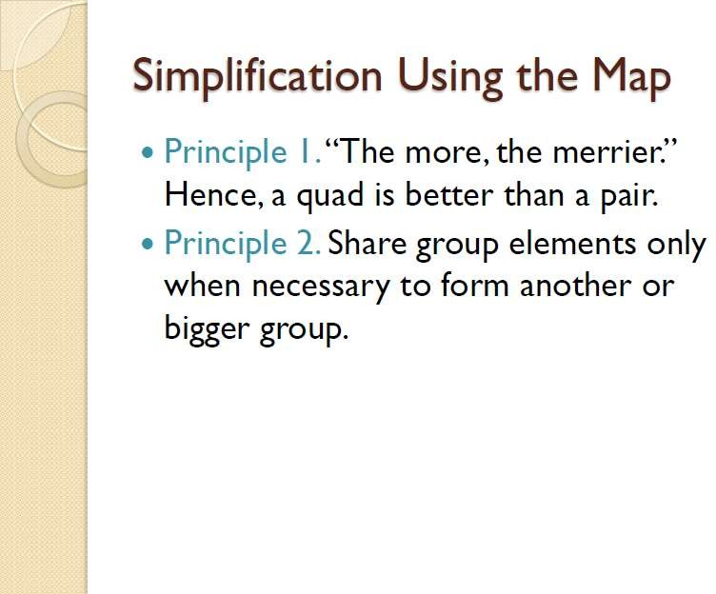

Slide 57
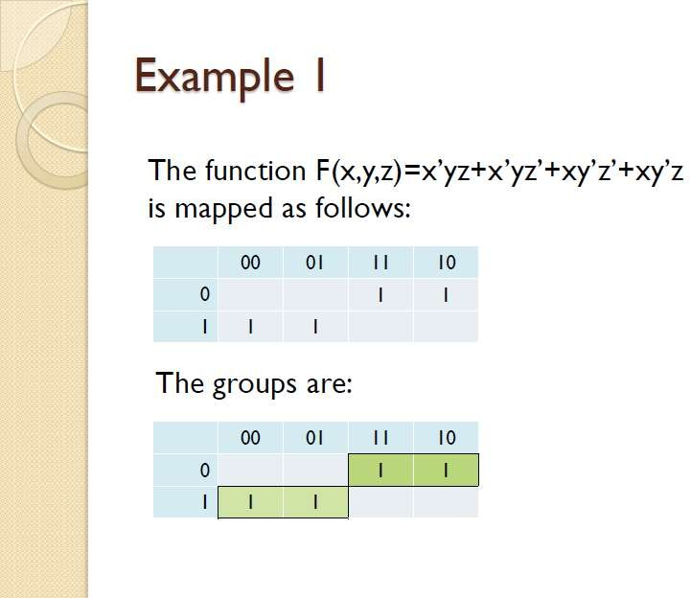

Slide 58
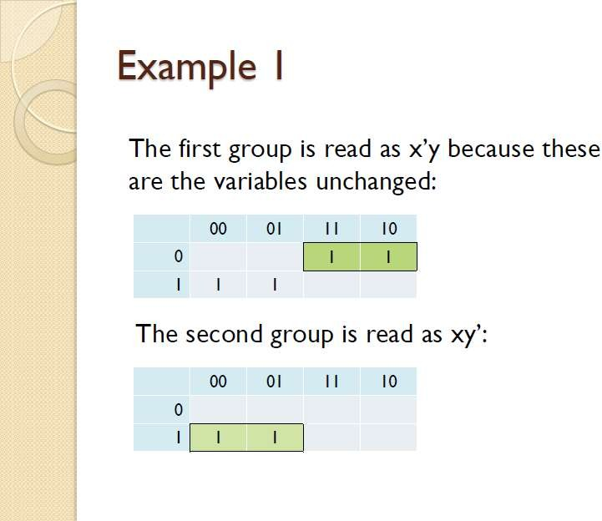

Slide 59
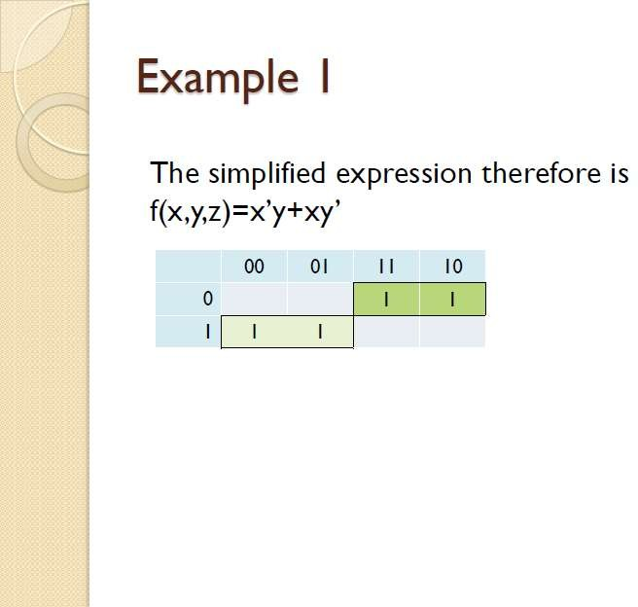

Slide 60
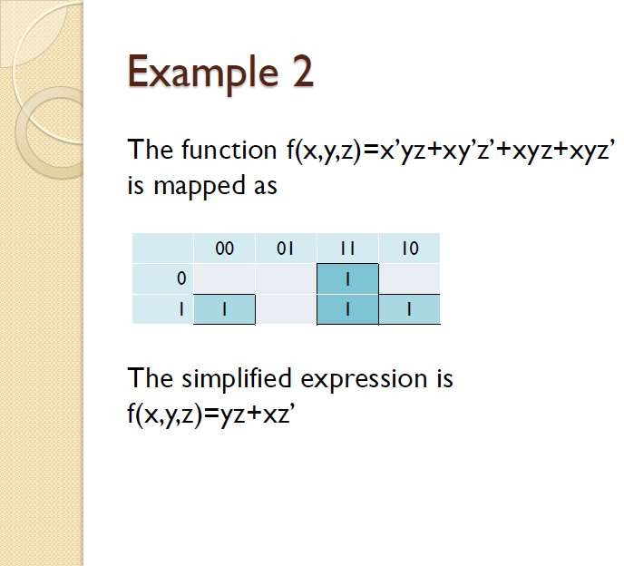

Slide 61
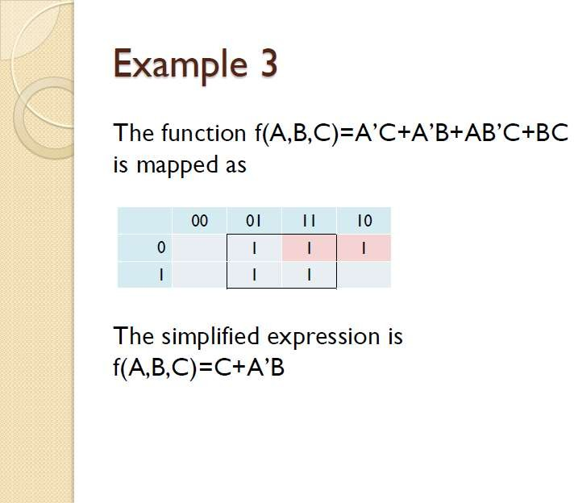

Slide 62
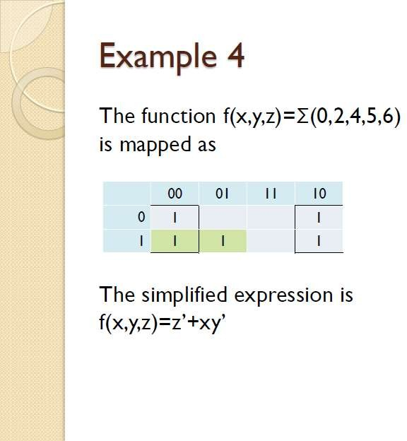

Slide 63


Do yourself
1.
2.
3.

Slide 64
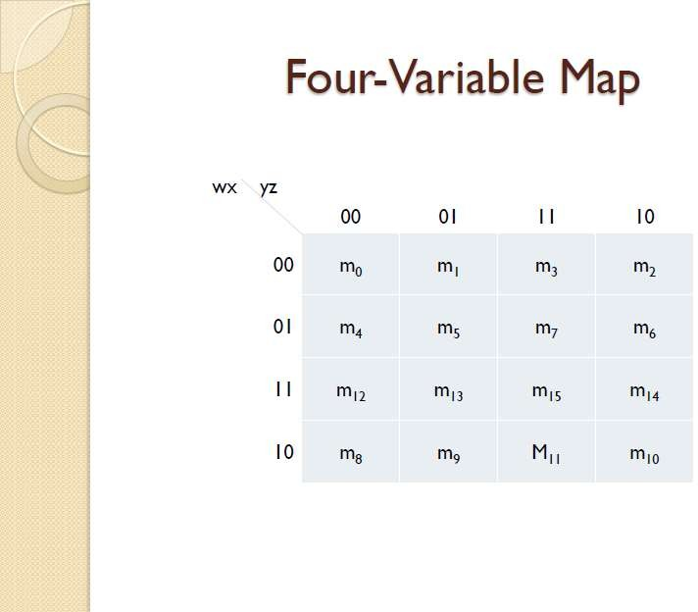

Slide 65
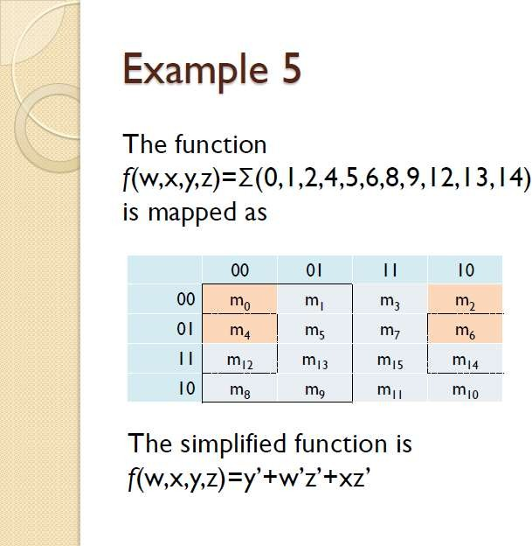

Slide 66
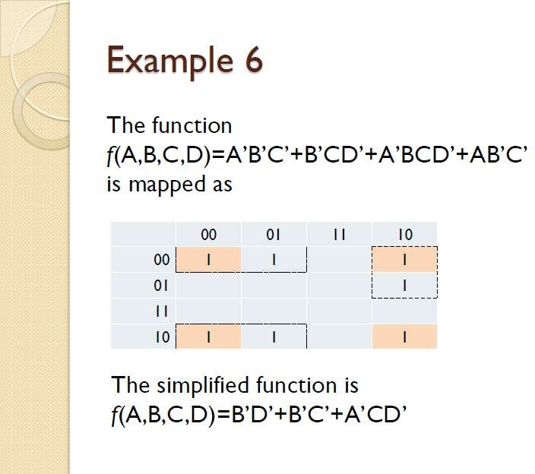

Slide 67

Do yourself
1.
2.
3.

Slide 68
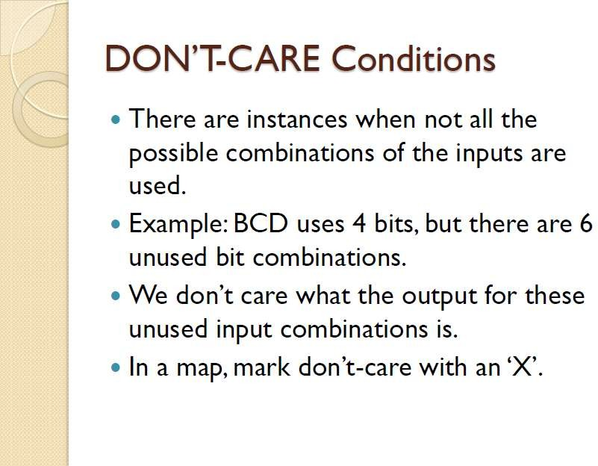

Slide 69
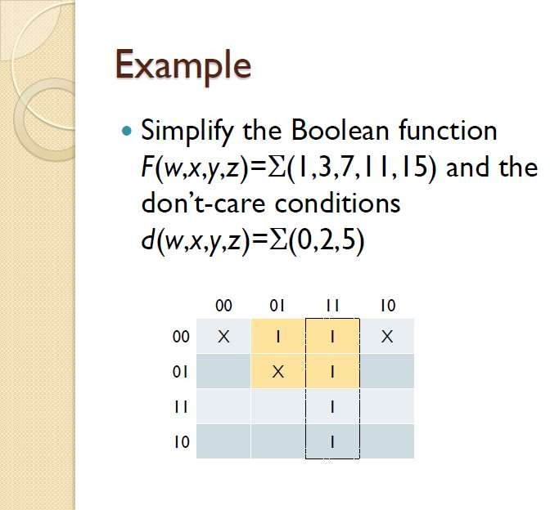

Slide 70
SIMPLIFICATION using KARNAUGH MAP
Exam 2:
F=∑ m(0,2,8,9,10,11,14,15)

Slide 71
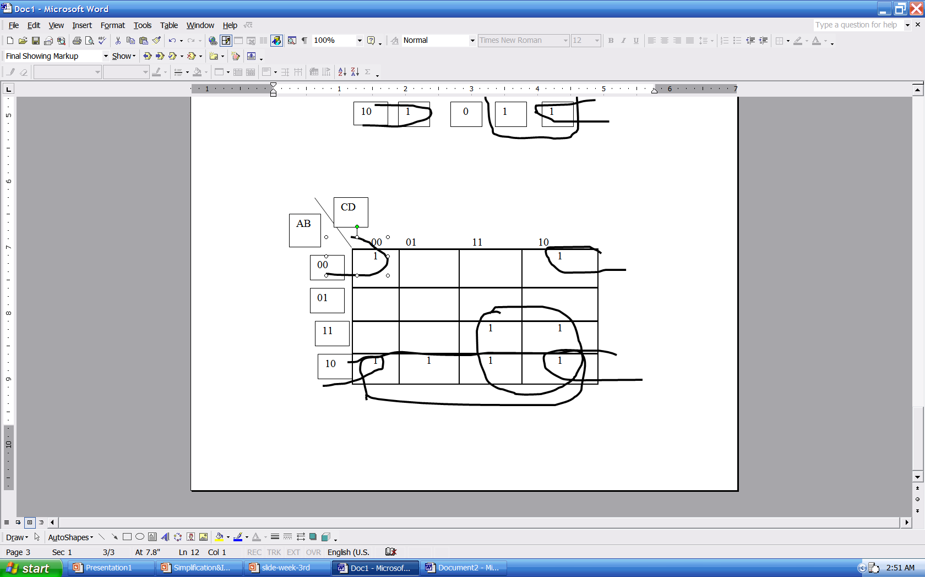
F= A.B’+A.C+B’.D’

Slide 72

K map(Karnaugh map)

Slide 73
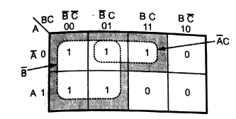
Y= B’+A’C

Slide 74
Minimize the expression
Y= A’BC’D’+A’BC’D+ABC’D’+ABC’D+AB’C’D+A’B’CD’

Slide 75
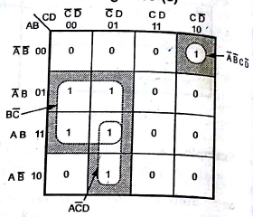
Y=A’B’CD’+AC’D+BC’

Slide 76
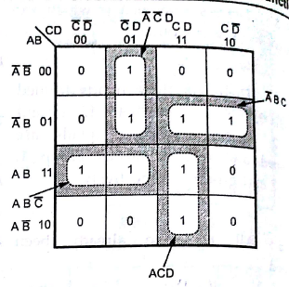


Slide 77
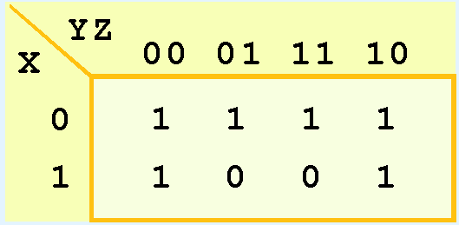
K-map Simplification for Three Variables
Simplify the function by using K-map

Slide 78
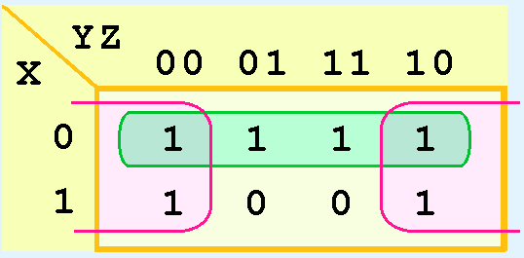

Slide 79

The green group in the top row tells us that only the value of x is significant in that group.
We see that it is complemented in that row, so the other term of the reduced function is .
Our reduced function is:

Slide 80
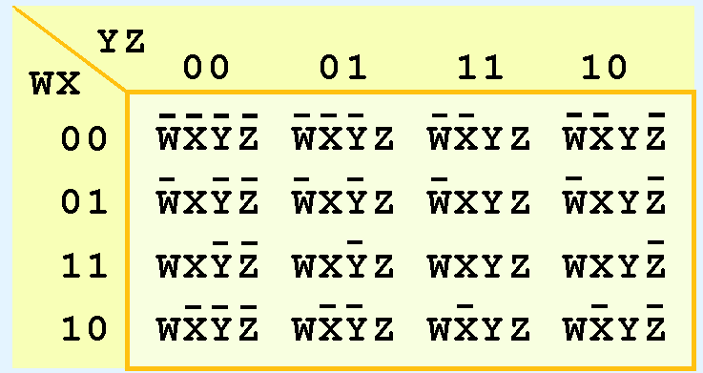
Kmap Simplification for Four Variables

Slide 81
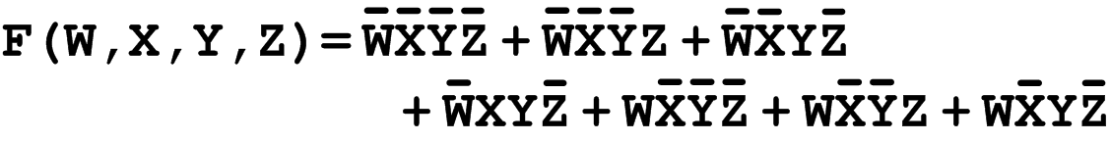
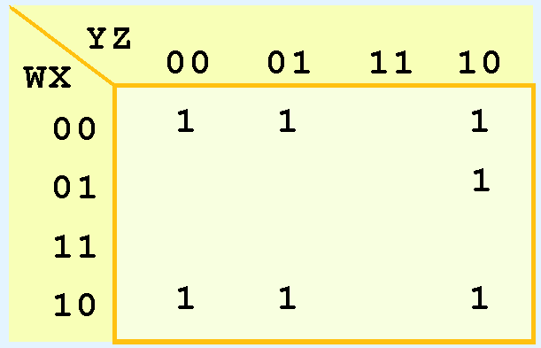
Simplify the given function by using K-map
Can you identify (only) three groups in this Kmap?

Slide 82
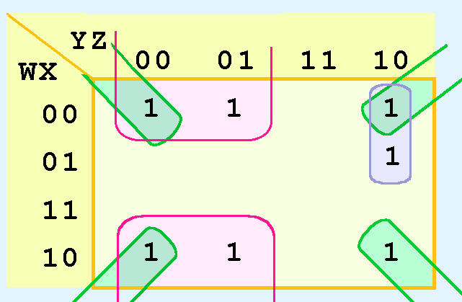
Hence: F= X’Y’+W’YZ’+X’Z’

Slide 83
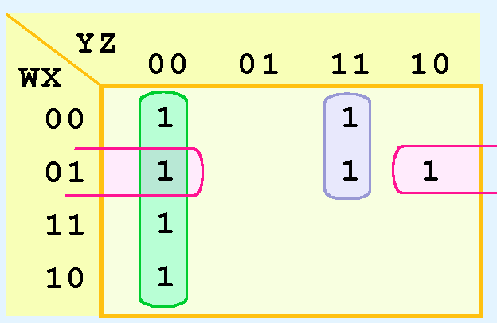
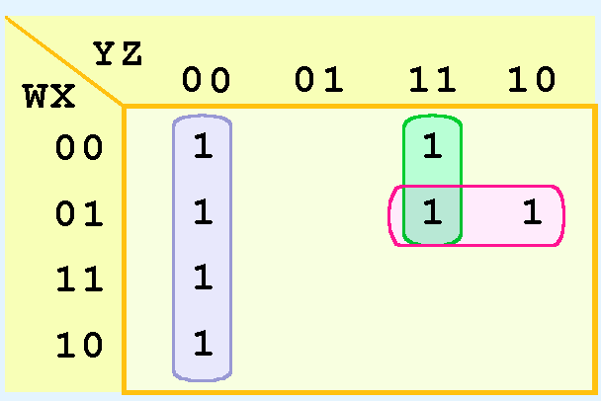
Simplification for Four Variables
It is possible to have a choice as to how to pick groups within a Kmap, while keeping the groups as large as possible.
The (different) functions that result from the groupings below are logically equivalent.

Slide 84
Quine and McCluskey -’QM’ method (Table Method)

Slide 85
An Example: F(x,y,z)=∑ m(2,3,6,7)

Slide 86
Results - Step 2

Slide 87
Step 3

Slide 88
The Results of Step 3

Slide 89
Computational Complexity Issues

Slide 90
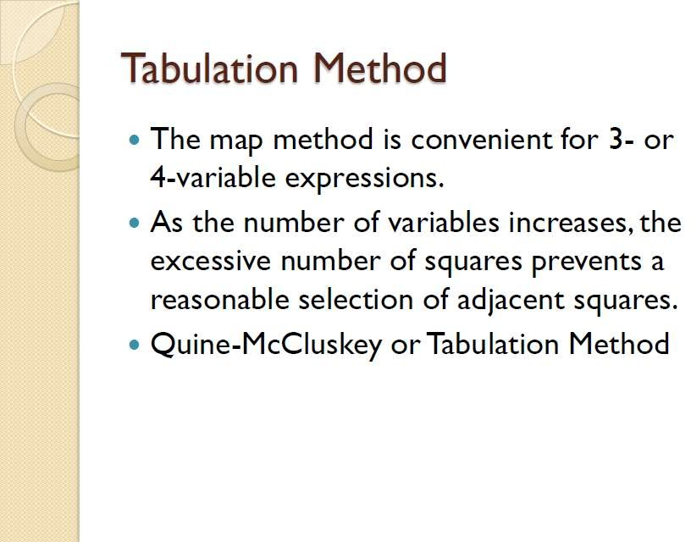

Slide 91
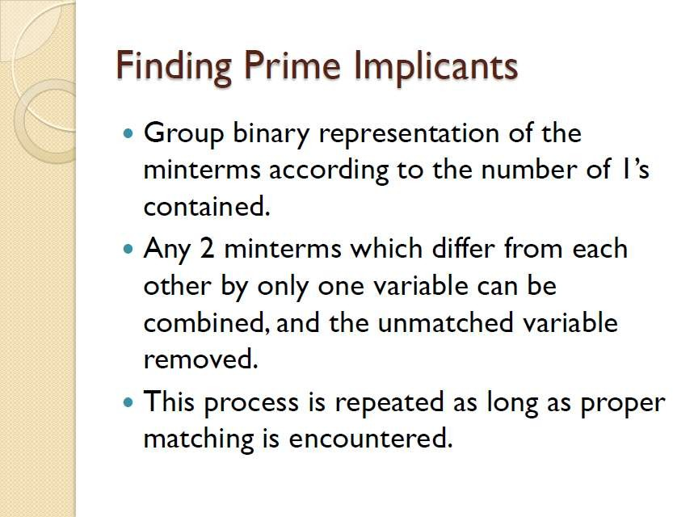

Slide 92
